Slide 1
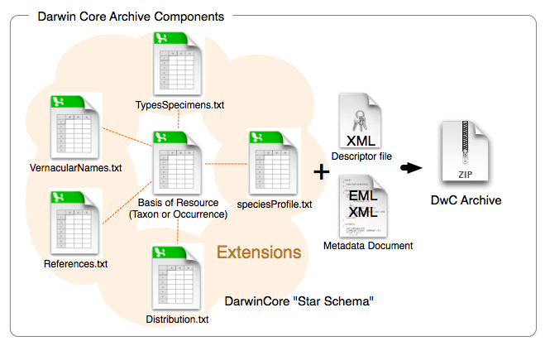

Darwin Core Archive
Darwin Core Archive (DwC-A) is the standard for publishing biodiversity data using Darwin Core terms
Star-schema

Slide 2
OBIS data formats
Occurrence Core
Occurrence Core
Event Core
Core
ExtendedMeasurementOrFact
Occurrence
Extensions
ExtendedMeasurementOrFact

Slide 3
Occurrence Core
When to use Occurrence Core?
No information on how the data was sampled or samples were processed.
No abiotic measurements are taken or provided
Biological measurements are made on individual specimens (each specimen is a single occurrence record)
This is often the case for museum collections, citations of occurrences from literature, individual sightings.
Minimum of 8 (required) DwC terms
scientificName | scientificNameID | occurrenceID | eventDate | decimalLatitude | decimalLongitude | occurrenceStatus | basisOfRecord
Arca zebra | urn:lsid:marinespecies.org:taxname:420713 | MCNUSB_001 | 1999-01-01 | 10.7413 | -63.8791 | Present | PreservedSpecimen
Perna viridis | urn:lsid:marinespecies.org:taxname:367822 | MCNUSB_002 | 1999-01-01 | 10.7413 | -63.8791 | Present | PreservedSpecimen
Phyllonotus pomum | urn:lsid:marinespecies.org:taxname:419944 | MCNUSB_003 | 1999-01-01 | 10.7413 | -63.8791 | Present | PreservedSpecimen
Strombus pugilis | urn:lsid:marinespecies.org:taxname:419695 | MCNUSB_047 | 1999-01-01 | 10.8737 | -63.8805 | Present | PreservedSpecimen
Trachycardium | urn:lsid:marinespecies.org:taxname:203976 | MCNUSB_075 | 1999-01-01 | 10.8477 | -68.2424 | Present | PreservedSpecimen
Chione cancellata | urn:lsid:marinespecies.org:taxname:397040 | MCNUSB_006 | 1999-01-01 | 10.6886 | -63.8514 | Present | PreservedSpecimen
Atrina seminuda | urn:lsid:marinespecies.org:taxname:420740 | MCNUSB_007 | 1999-01-01 | 10.6886 | -63.8514 | Present | PreservedSpecimen
Lyropecten | urn:lsid:marinespecies.org:taxname:203879 | MCNUSB_004 | 1999-01-01 | 10.7413 | -63.8791 | Present | PreservedSpecimen

Slide 4
Occurrence Core + ExtendedMeasurementOrFact Extension
Occurrences and measurements made on individual specimens, e.g. body size, counts, wet weight, life stage, etc.
scientificName | scientificNameID | occurrenceID | eventDate | decimalLatitude | decimalLongitude | occurrenceStatus | basisOfRecord
Arca zebra | urn:lsid:marinespecies.org:taxname:420713 | MCNUSB_001 | 1999-01-01 | 10.7413 | -63.8791 | Present | PreservedSpecimen
Perna viridis | urn:lsid:marinespecies.org:taxname:367822 | MCNUSB_002 | 1999-01-01 | 10.7413 | -63.8791 | Present | PreservedSpecimen
Phyllonotus pomum | urn:lsid:marinespecies.org:taxname:419944 | MCNUSB_003 | 1999-01-01 | 10.7413 | -63.8791 | Present | PreservedSpecimen
Strombus pugilis | urn:lsid:marinespecies.org:taxname:419695 | MCNUSB_047 | 1999-01-01 | 10.8737 | -63.8805 | Present | PreservedSpecimen
Trachycardium | urn:lsid:marinespecies.org:taxname:203976 | MCNUSB_075 | 1999-01-01 | 10.8477 | -68.2424 | Present | PreservedSpecimen
Chione cancellata | urn:lsid:marinespecies.org:taxname:397040 | MCNUSB_006 | 1999-01-01 | 10.6886 | -63.8514 | Present | PreservedSpecimen
Atrina seminuda | urn:lsid:marinespecies.org:taxname:420740 | MCNUSB_007 | 1999-01-01 | 10.6886 | -63.8514 | Present | PreservedSpecimen
Lyropecten | urn:lsid:marinespecies.org:taxname:203879 | MCNUSB_004 | 1999-01-01 | 10.7413 | -63.8791 | Present | PreservedSpecimen
occurrenceID | measurementType | measurementTypeID | measurementValue | measurementValueID | measurementUnit | measurementUnitID
MCNUSB_001 | Length | http://vocab.nerc.ac.uk/collection/P01/current/OBSINDLX | 4 |  | cm | http://vocab.nerc.ac.uk/collection/P06/current/ULCM
MCNUSB_001 | Wetweightbiomass | http://vocab.nerc.ac.uk/collection/P01/current/OWETBM01 | 10 |  | gr | http://vocab.nerc.ac.uk/collection/P06/current/UGRM/
MCNUSB_002 | Length | http://vocab.nerc.ac.uk/collection/P01/current/OBSINDLX | 3 |  | cm | http://vocab.nerc.ac.uk/collection/P06/current/ULCM
MCNUSB_002 | Wetweightbiomass | http://vocab.nerc.ac.uk/collection/P01/current/OWETBM01 | 15 |  | gr | http://vocab.nerc.ac.uk/collection/P06/current/UGRM/
MCNUSB_003 | Length | http://vocab.nerc.ac.uk/collection/P01/current/OBSINDLX | 8 |  | cm | http://vocab.nerc.ac.uk/collection/P06/current/ULCM
MCNUSB_003 | Wetweightbiomass | http://vocab.nerc.ac.uk/collection/P01/current/OWETBM01 | 80 |  | gr | http://vocab.nerc.ac.uk/collection/P06/current/UGRM/

Slide 5
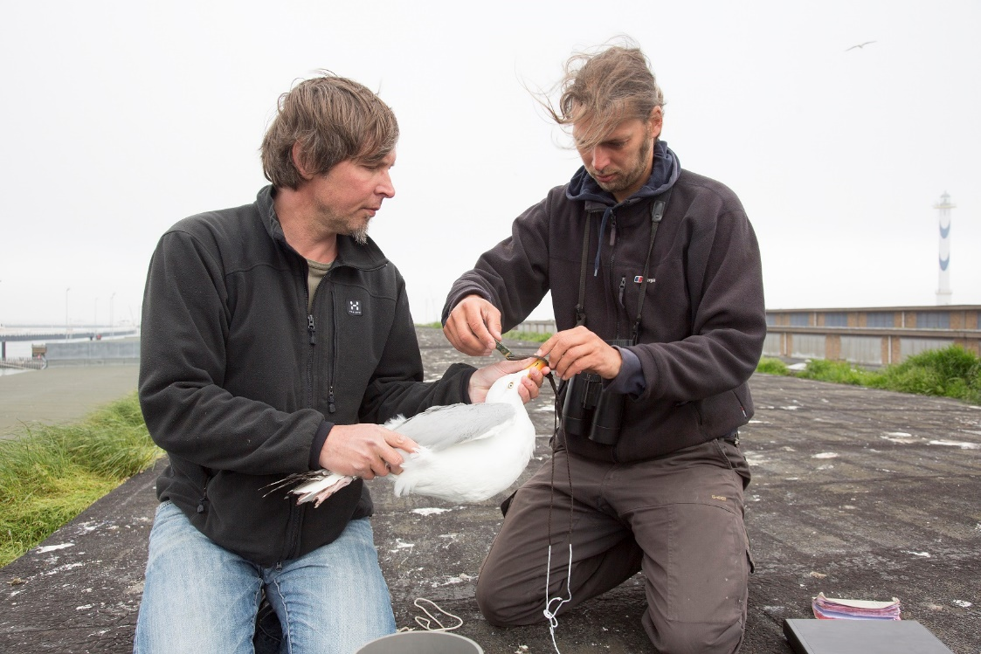
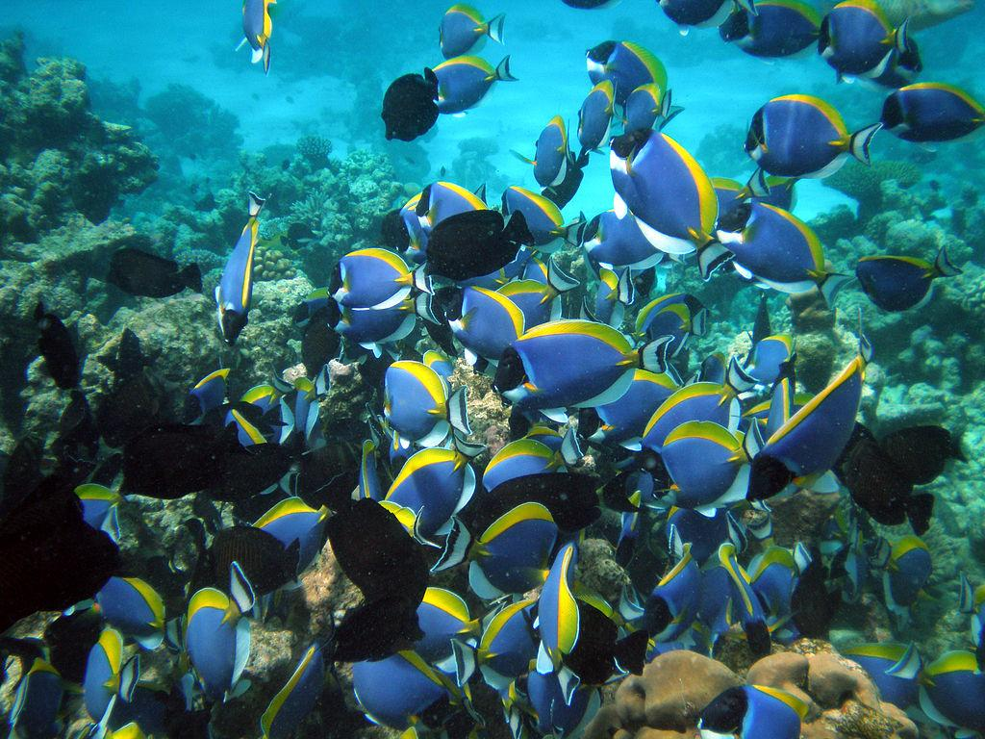
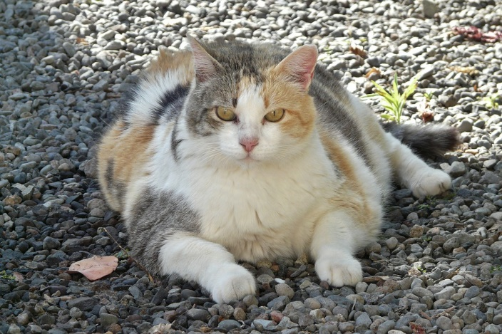
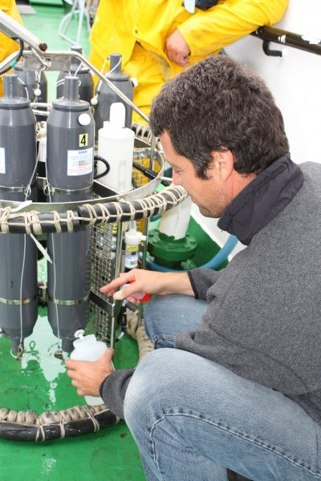
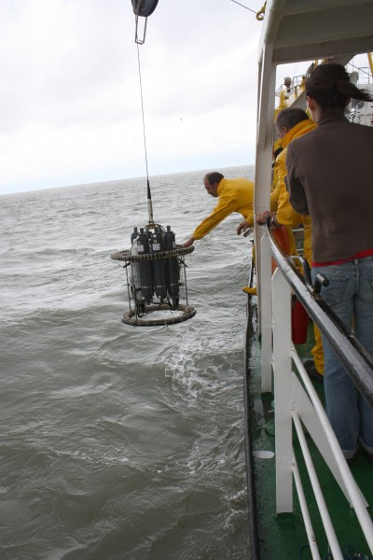
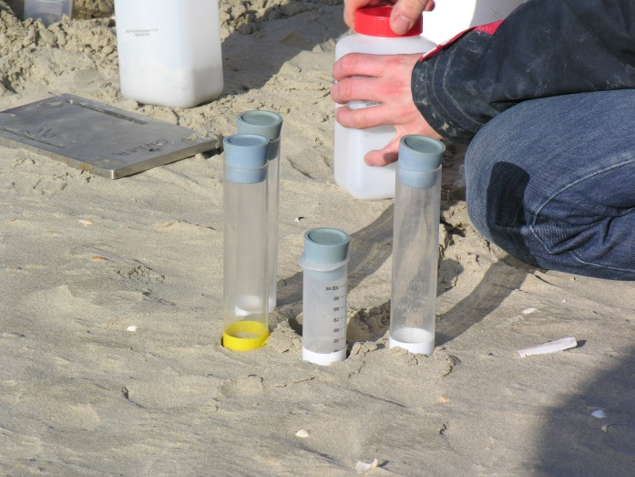
Biotic measurements
Abundances
Biomass
Sediment sampling
CTD measurements
Nutrient concentrations

Slide 6
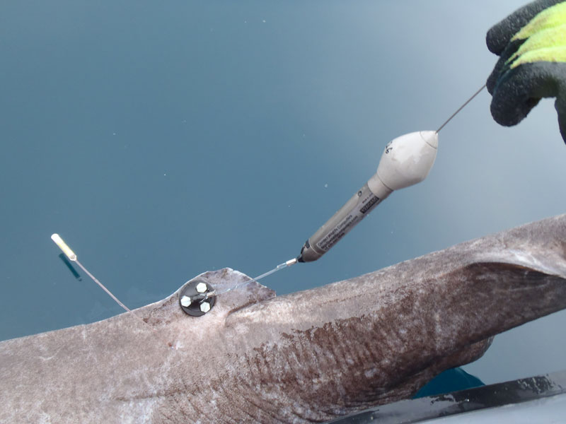
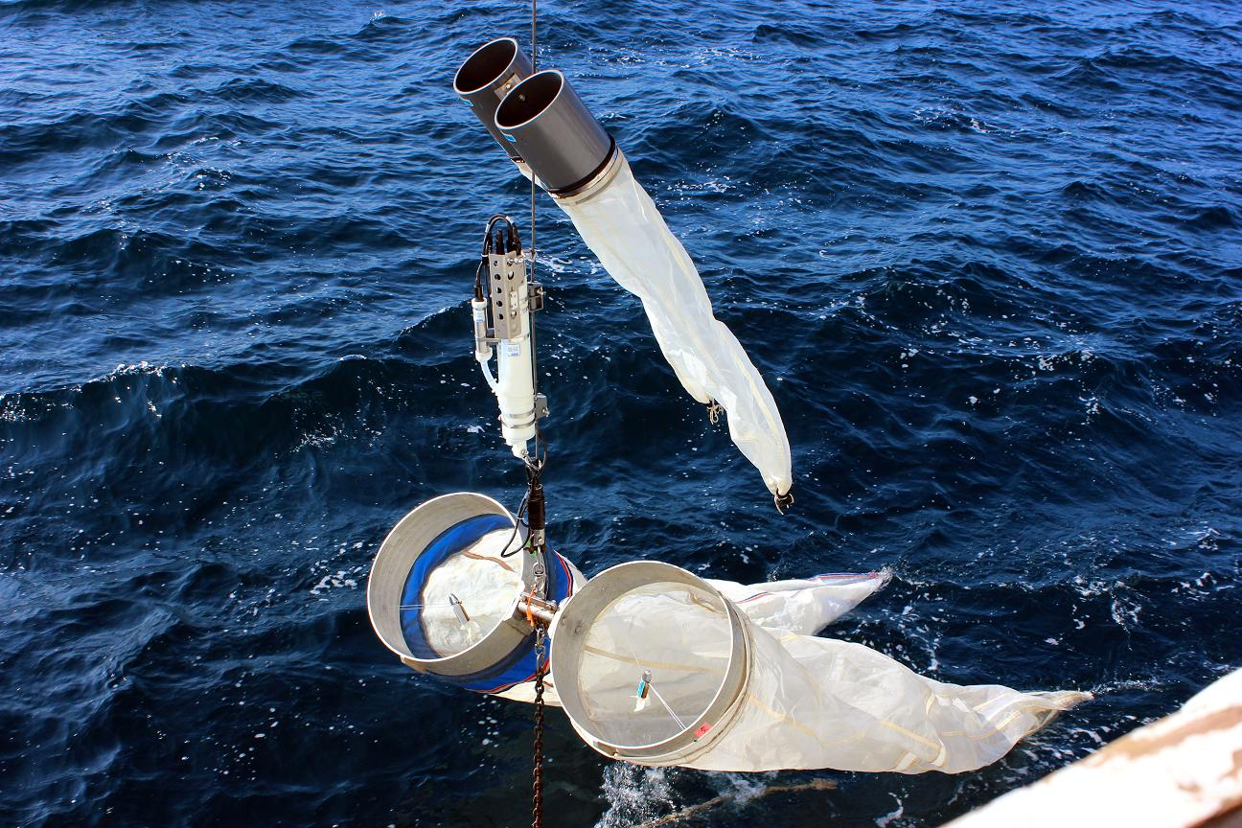
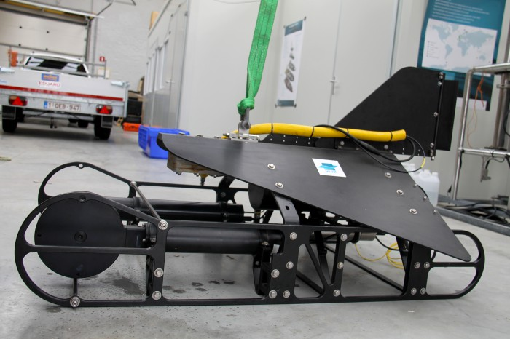
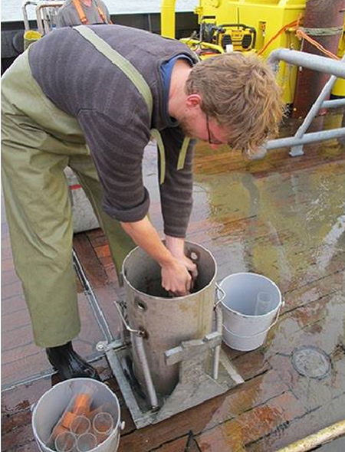
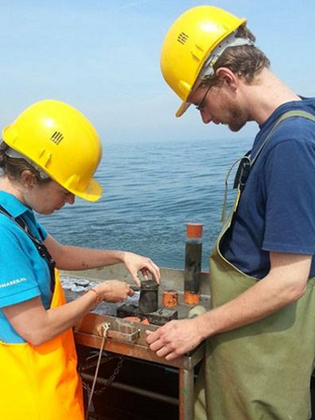
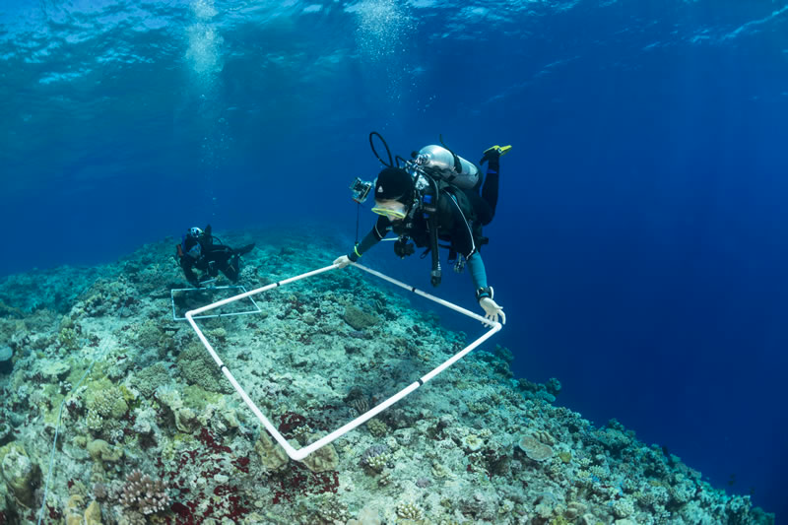
OTN tags
Planktonnet + CTD
VPR
livingoceansfoundation
Subsamples and slices
Habitat coverage - bleaching

Slide 7
Event Core + Occurrence Extension
eventID | parentEventID | type | eventDate | decimalLatitude | decimalLongitude | coordinateUncertaintyInMeters | minimumDepthInMeters | maximumDepthInMeters | footprintWKT
plankton_nov2009 |  | cruise | 2009-11-25
plankton_nov2009:S1 | plankton_nov2009 | station | 2009-11-25 | 10.854039 | -63.697436 |  | 1 | 2
plankton_nov2009:S1:dragging | plankton_nov2009:S1 | Plankton transect | 2009-11-25 | 10.853500 | -63.698400 | 33 | 1 | 2 | LINESTRING (-63.69870 10.85351, -63.69809 10.85352)
plankton_nov2009:S1:dragging:T1 | plankton_nov2009:S1:dragging | CTD | 2009-11-25 | 10.853450 | -63.698586 |  | 1 | 2
plankton_nov2009:S1:dragging:T2 | plankton_nov2009:S1:dragging | CTD | 2009-11-25 | 10.853469 | -63.698422 |  | 1 | 2
plankton_nov2009:S1:dragging:T3 | plankton_nov2009:S1:dragging | CTD | 2009-11-25 | 10.853492 | -63.698511 |  | 1 | 2
eventID | occurrenceID | scientificName | scientificNameID | scientificNameAuthorship | basisOfRecord | occurrenceStatus
plankton_nov2009:S1:dragging | MCNUSB_plank0001 | Rhizosolenia | urn:lsid:marinespecies.org:taxname:149069 | T. Brightwell, 1858 | HumanObservation | Present
plankton_nov2009:S1:dragging | MCNUSB_plank0002 | Noctiluca scintillans | urn:lsid:marinespecies.org:taxname:109921 | (Macartney) Kofoid & Swezy, 1921 | HumanObservation | Present
plankton_nov2009:S1:dragging | MCNUSB_plank0003 | Thalassiothrix frauenfeldii | urn:lsid:marinespecies.org:taxname:176365 | (Grunow) Grunow, 1880 | HumanObservation | Present
plankton_nov2009:S1:dragging | MCNUSB_plank0004 | Ceratium fusus | urn:lsid:marinespecies.org:taxname:109951 | (Ehrenberg) Dujardin, 1841 | HumanObservation | Present
plankton_nov2009:S1:dragging | MCNUSB_plank0005 | Chaetoceros coarctatum | urn:lsid:marinespecies.org:taxname:178180 | Lauder, 1864 | HumanObservation | Present
plankton_nov2009:S2:dragging | MCNUSB_plank0006 | Chaetoceros | urn:lsid:marinespecies.org:taxname:148985 | C.G. Ehrenberg, 1844 | HumanObservation | Present
plankton_nov2009:S2:dragging | MCNUSB_plank0007 | Guinardia | urn:lsid:marinespecies.org:taxname:149111 | H. Peragallo, 1892 | HumanObservation | Present
Measurements and Sampling facts?

Slide 8
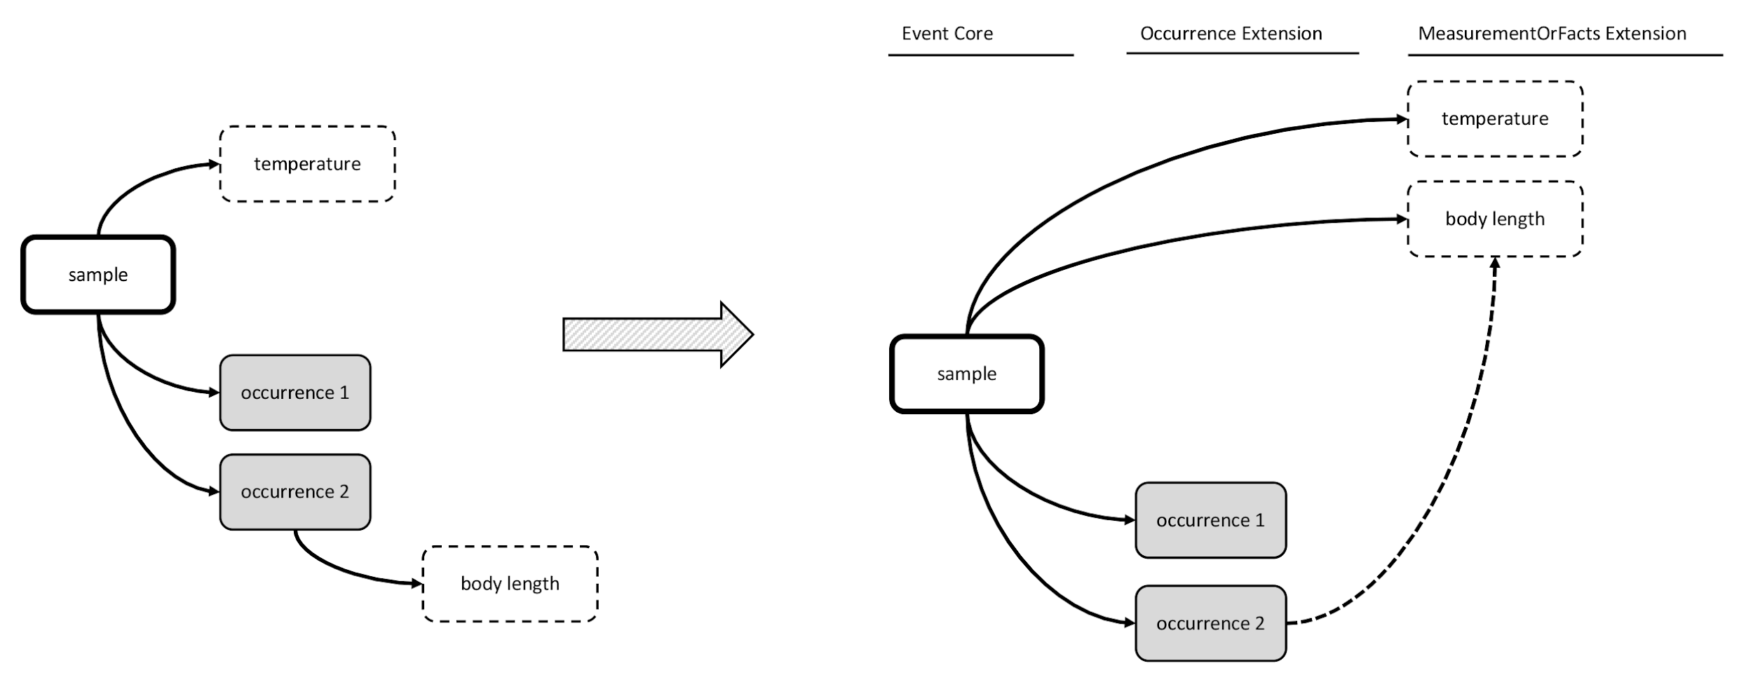
MeasurmentOrFact Extension
X
Not compatible with DwC-A star schema

Slide 9
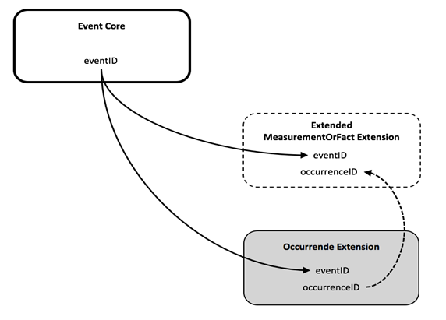
OBIS-ENV-DATA proposed the ExtendedMeasurementOrFact Extension
Three files:
Sample or Observation (time, location, depth, event hierarchy)
Sampling protocol
(equipment, methods)
Sampling effort
(length, duration, volume,…)
Environment/habitat variables
(physical, chemical, sediment,…)
Biological variables
(Abundance, biomass, length, behavior, lifestage, traits …)
Occurrence details
(taxonomy, identification, organismID. …)
Note: All Measurement Types, Values and Units are standardized against a controlled vocabulary (BODC NERC Vocab)

Slide 10
Event Core
When to use Event Core?
When the dataset contains abiotic measurements, or other biological measurements which are related to an entire sample (not a single specimen)
When specific details are known about how a biological sample was taken and processed.
Event Core should be used in combination with the Occurrence Extension and the ExtendedMeasurementOrFact Extension.

Slide 11
ExtendedMeasurementOrFact Extension (eMoF)
The eMoF extension is used to store:
Organism quantifications (e.g. counts, abundance, biomass, % live cover, etc.)
Species biometrics (e.g. body length, weight, etc.)
Facts documenting a specimen (e.g. sex, lifestage, living/dead, behavior, invasiveness, etc.)
Abiotic measurements (e.g. temperature, salinity, oxygen, sediment grain size, habitat features)
Facts documenting the sampling activity (e.g. sampling device, sampled area, sampled volume, sieve mesh size).

Slide 12
DwC terms
Event
Occurrences
MeasurementOrFacts
eventID
parentEventID
eventDate
habitat
minimumDepthInMeters
maximumDepthInMeters
decimalLatitude
decimalLongitude
coordinateUncertaintyInMeters
footprintWKT
modified
eventID
occurrenceID
scientificName
scientificNameAuthorship
scientificNameID
kingdom
taxonRank
identificationQualifier
occurrenceStatus
basisOfRecord
modified
measurementID
eventID
occurrenceID
measurementType
measurementTypeID
measurementValue
measurementValueID
measurementUnit
measurementUnitID
measurementAccuracy
measurementRemarks
NERC vocab
NERC vocab
NERC vocab

Slide 13
Event Core – OBIS-ENV-Data schema
Event 1
eMoF A1
vocab
Event 1.1
eMoF A2
vocab
Event 1.1.1
eMoF B1
vocab
Occ 1
vocab
eMoF B3
Occ 3
WoRMS
Occ 2
WoRMS
eMoF B2
vocab
WoRMS

Slide 14
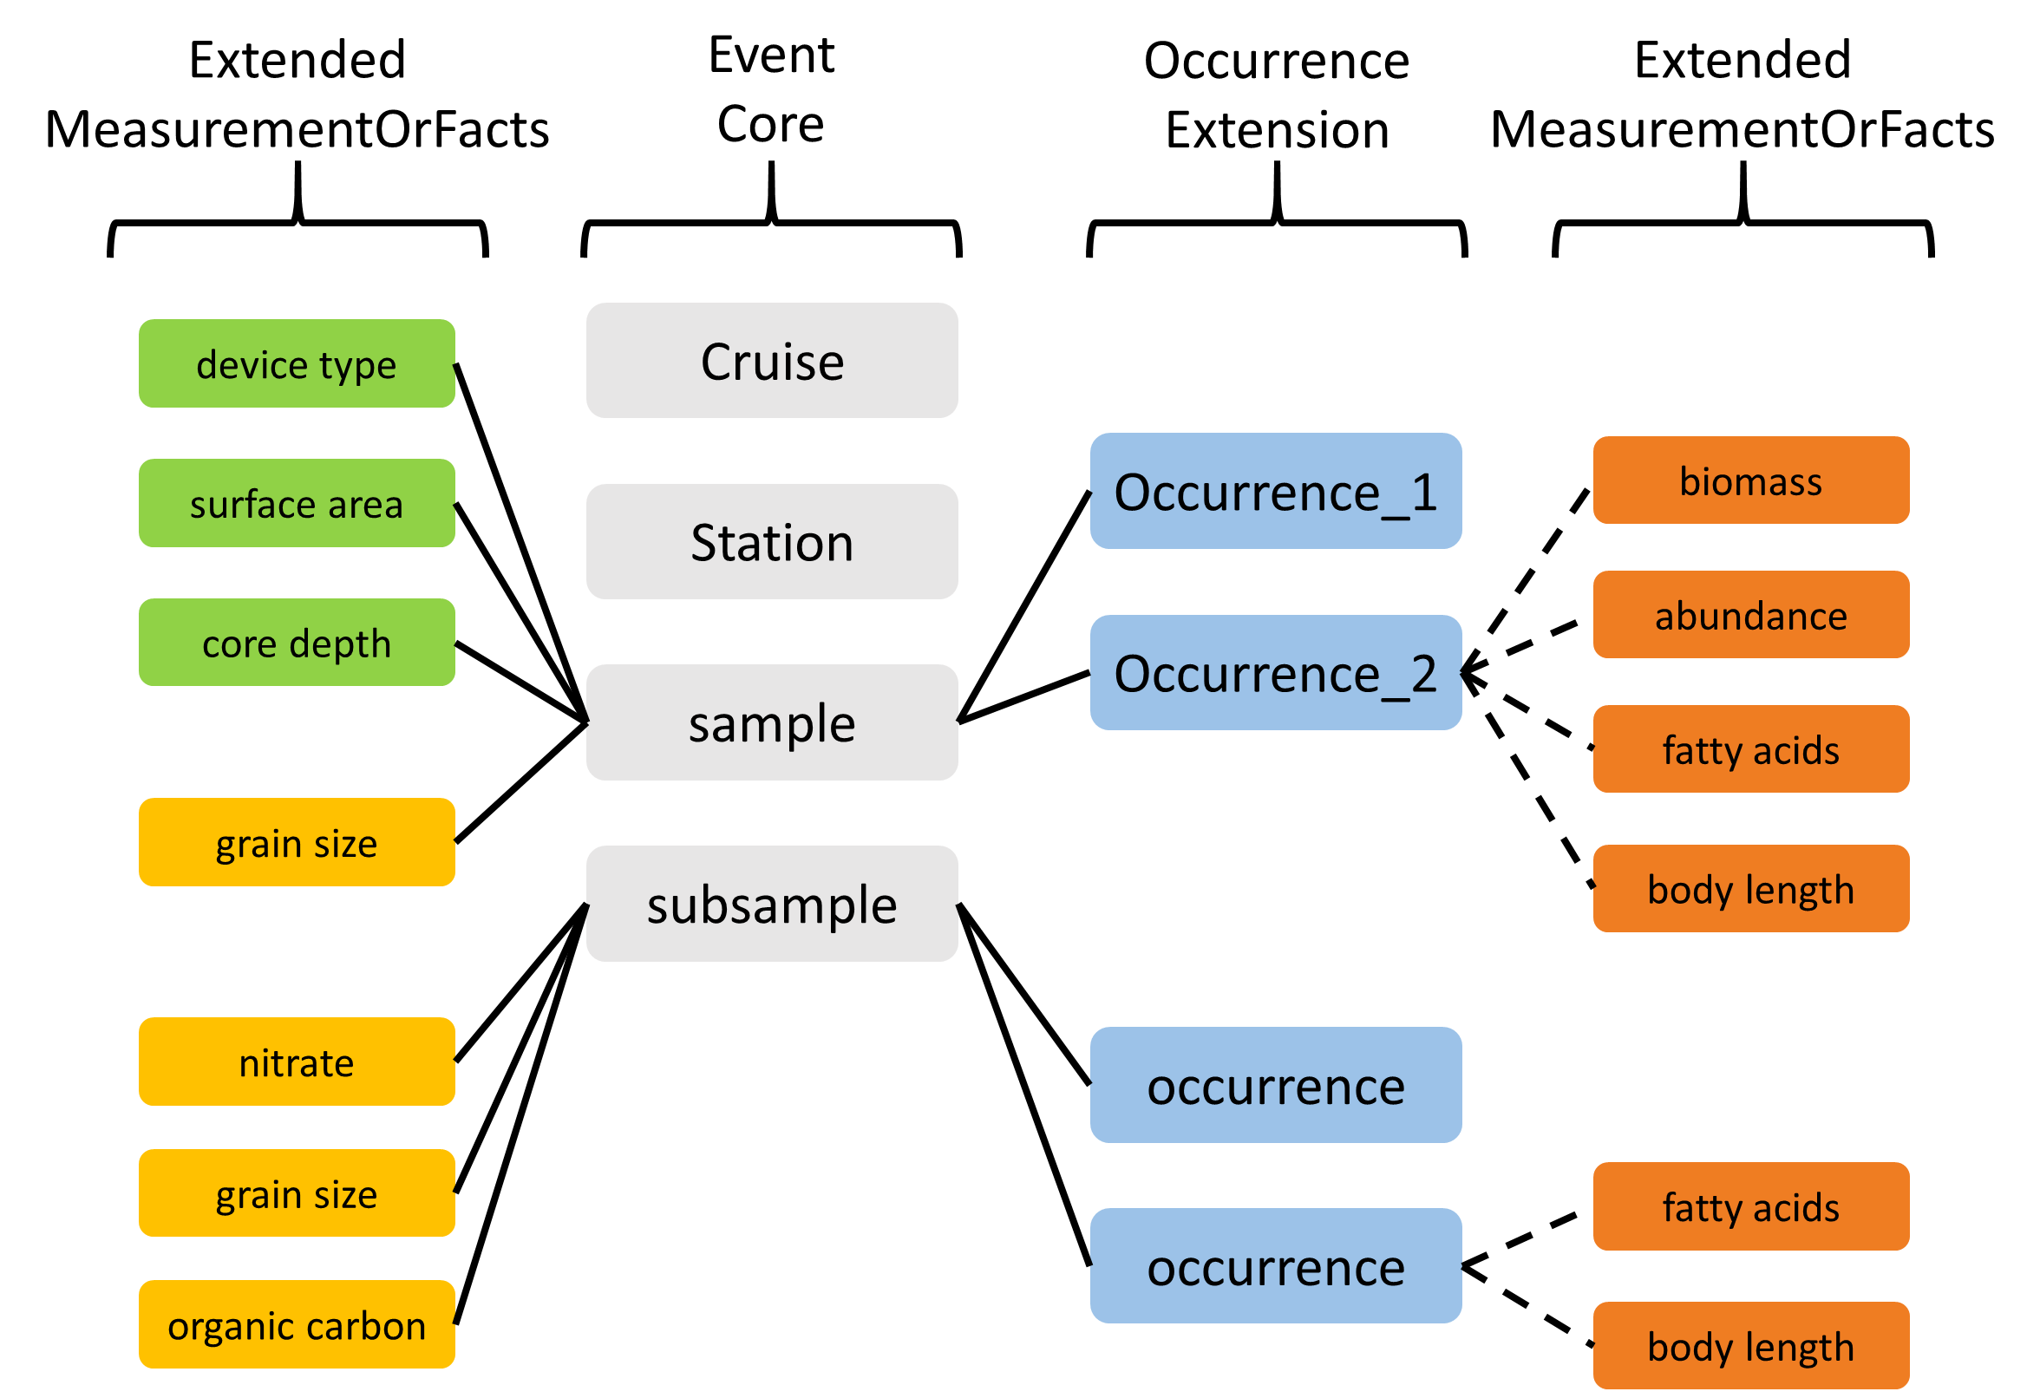

Slide 15
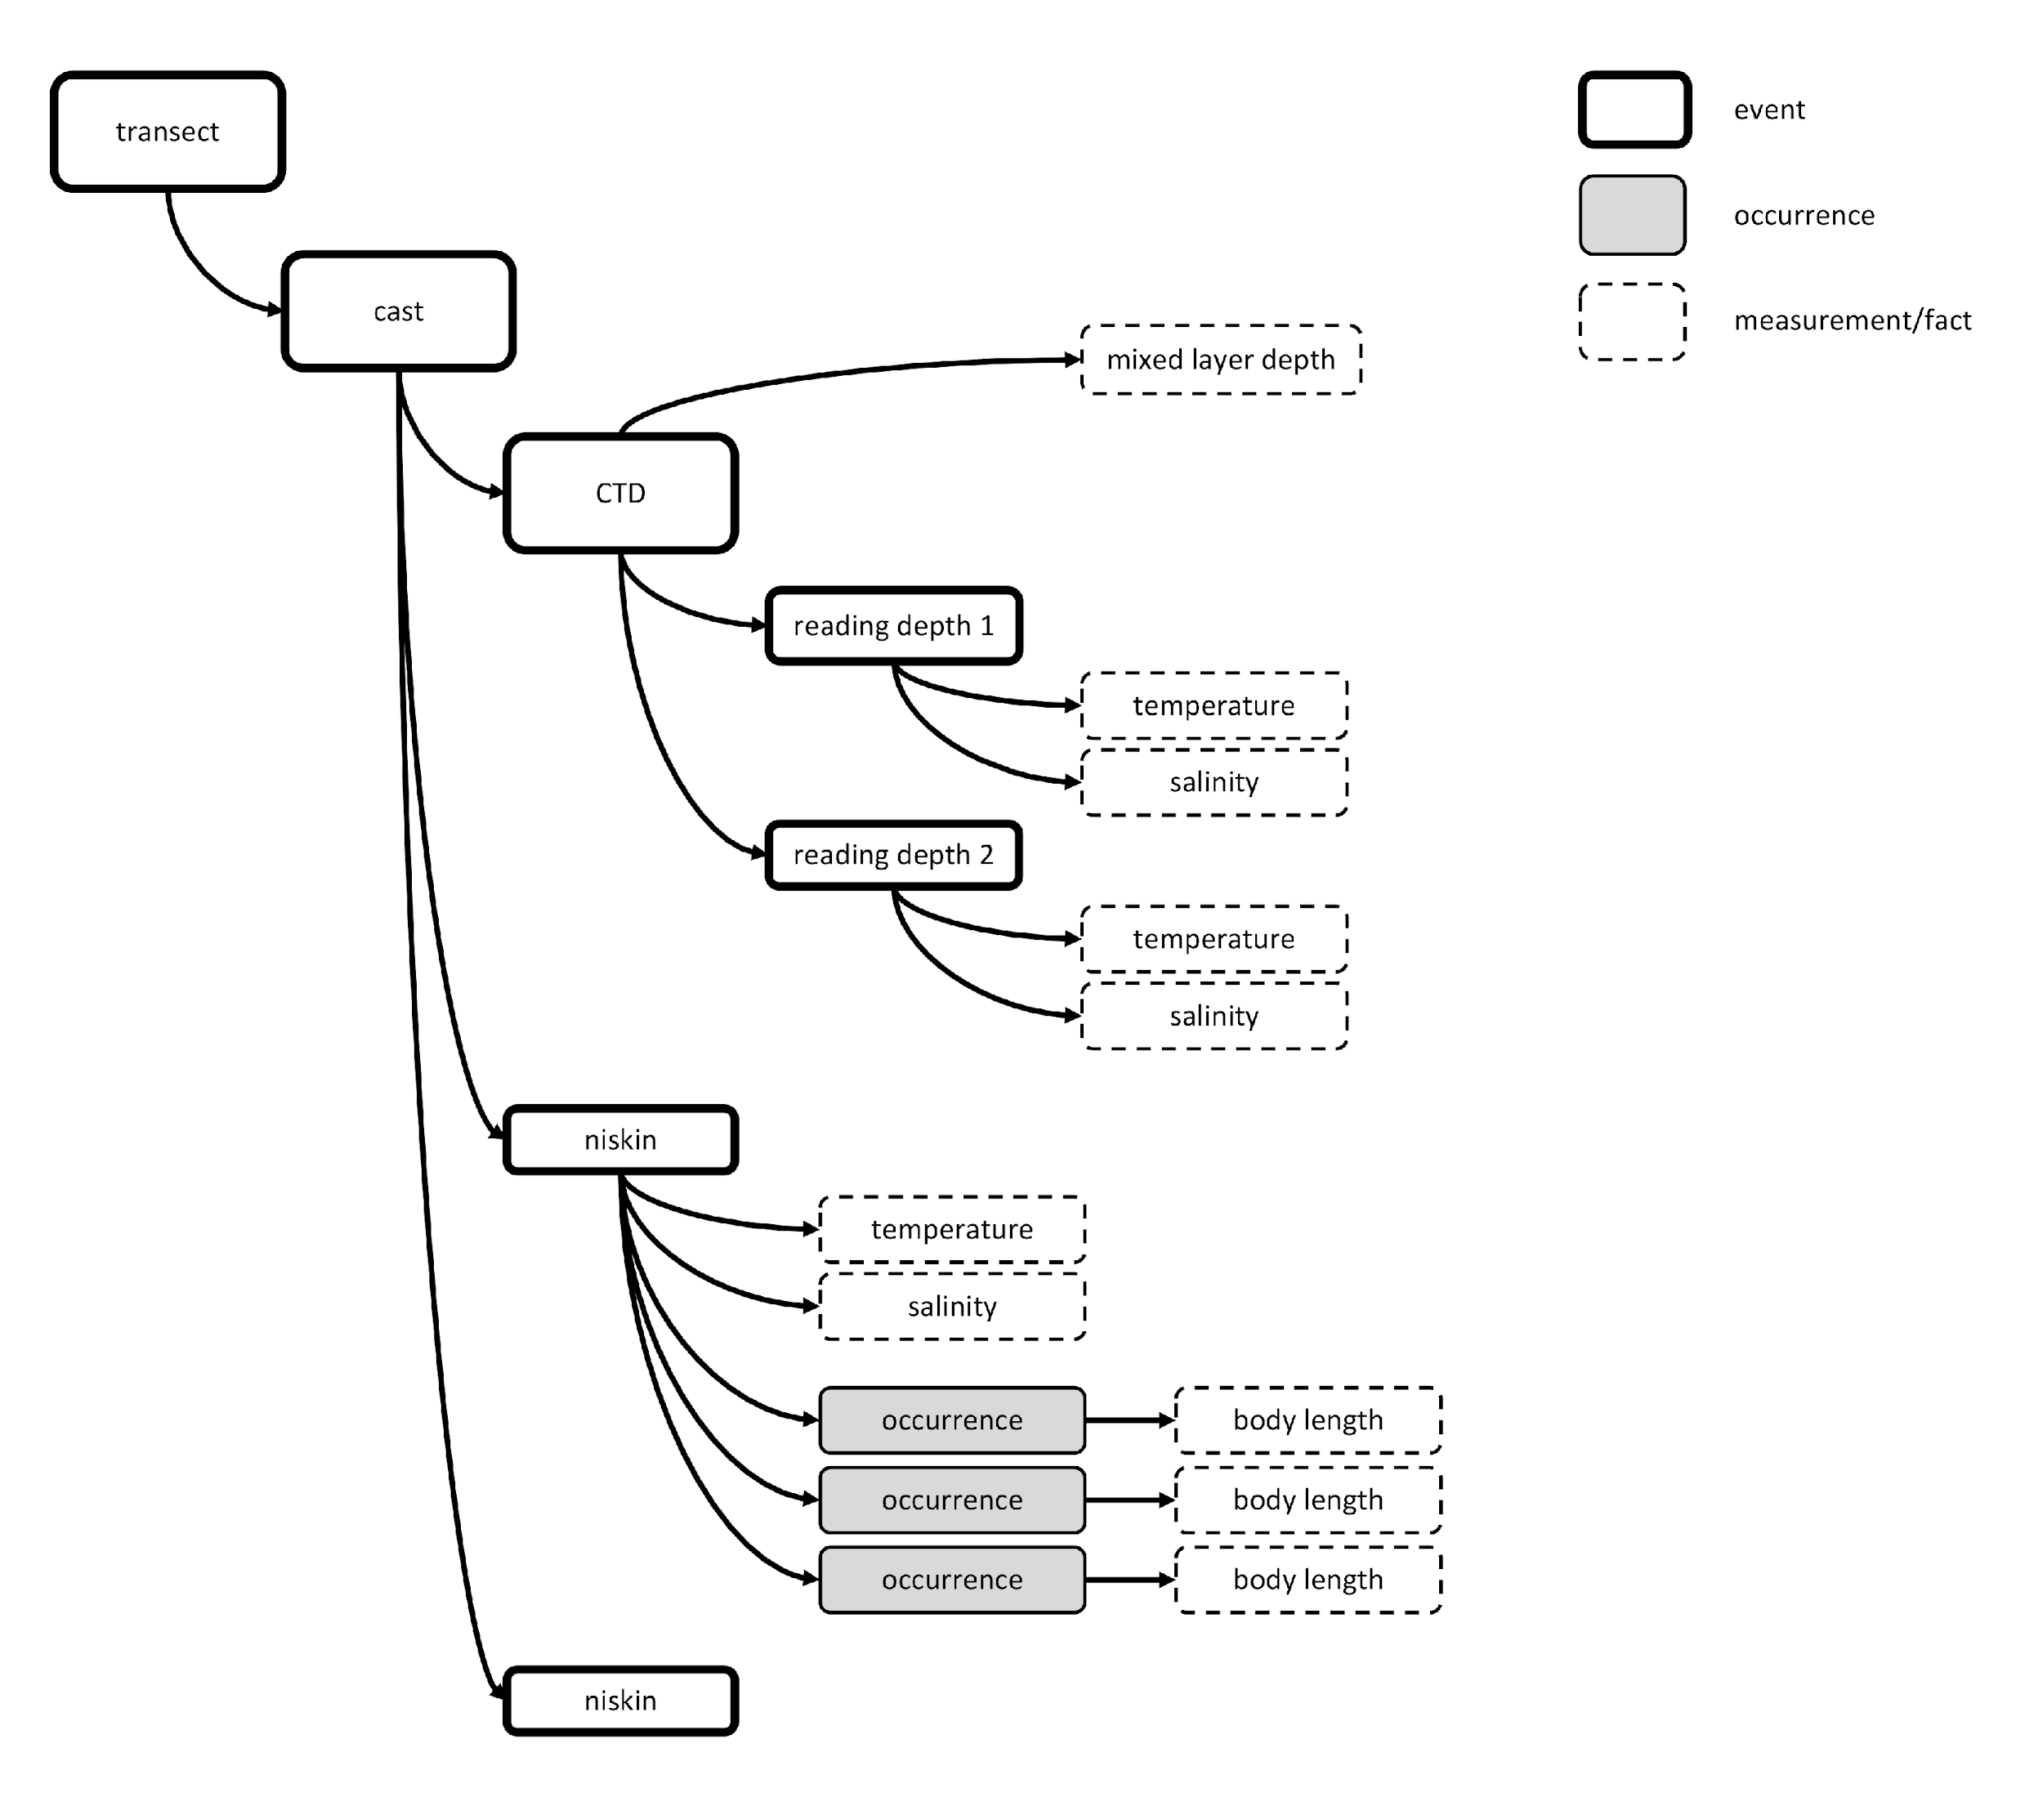
CTD measurements

Slide 16
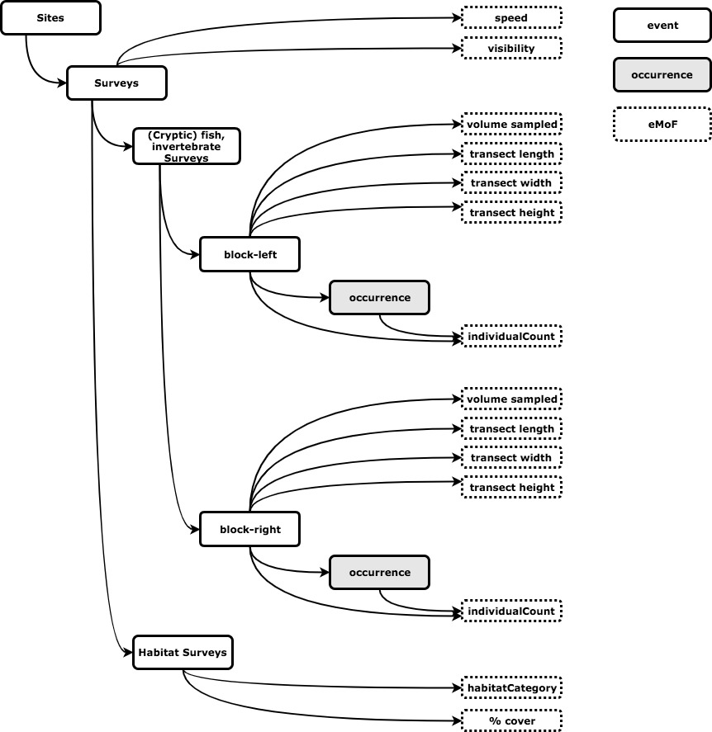

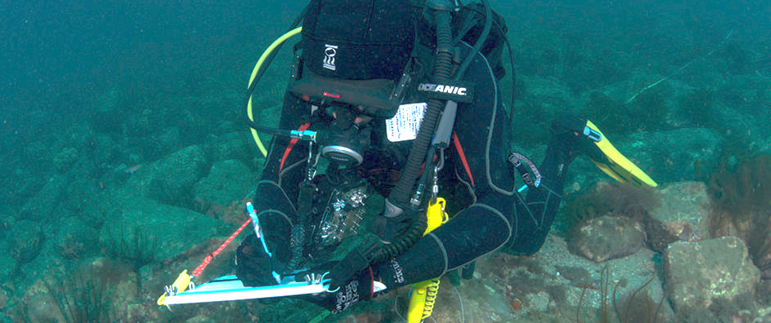
Example subset

Slide 17
Measurements or facts Vocabulary
The MoF terms: measurementType, measurementValue and measurementUnit are completely unconstrained and can be populated with free text annotation.
OBIS uses the controlled vocabulary developed and maintained by the British Oceanographic Data Center (BODC), and made available through the NERC Vocabulary server: https://www.bodc.ac.uk/resources/vocabularies/vocabulary_search/.
measurementTypeID
BODC Parameter Usage Vocabulary (P01): http://vocab.nerc.ac.uk/collection/P01/current
OBIS sampling instruments and methods attributes (Q01): http://vocab.nerc.ac.uk/collection/Q01/current/
measurementValueID
Sampling instruments and sensors (SeaVoX Device Catalogue): http://vocab.nerc.ac.uk/collection/L22/current
Sampling instrument categories (SeaDataNet device categories): http://vocab.nerc.ac.uk/collection/L05/current
Vessels (ICES Platform Codes): http://vocab.nerc.ac.uk/collection/C17/current
Lifestage: http://vocab.nerc.ac.uk/collection/S11/current/
DOIs of papers or manuals on the sampling protocol used, published e.g. on IOC’s Ocean Best Practices repository, for example: http://hdl.handle.net/11329/304
MeasurementUnitID
Units: http://vocab.nerc.ac.uk/collection/P06/current

Slide 18
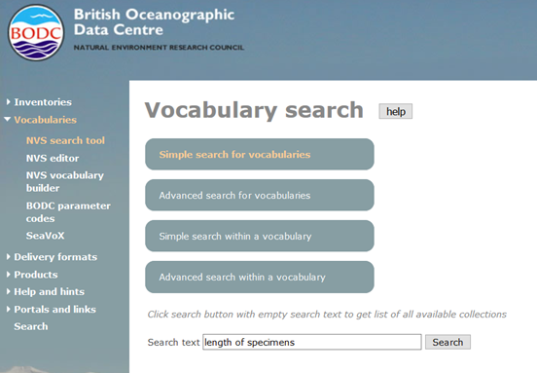
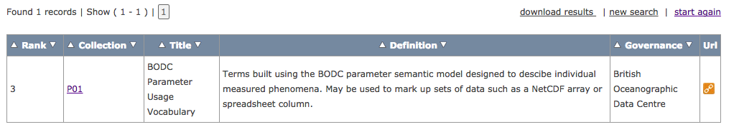
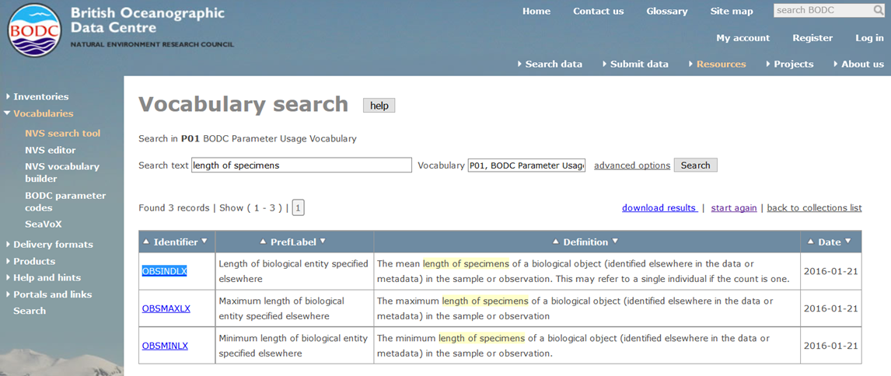
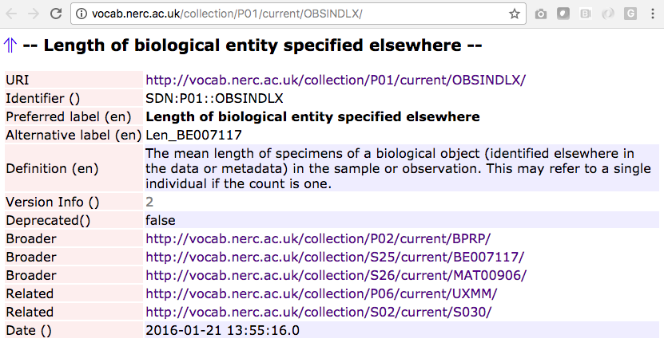
https://www.bodc.ac.uk/resources/vocabularies/vocabulary_search/.

Slide 19
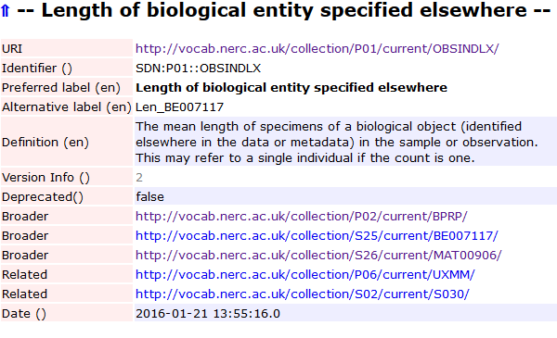
Data Standardisation
MeasurementType
MeasurementValue
MeasurementUnit
+ MeasurementTypeID
+ MeasurementValueID
+ MeasurementUnitID
Extended MoF Extension
Controlled vocabulary
Persistent identifiers (URIs)
MeasurementType MeasurementTypeID
Body length http://vocab.nerc.ac.uk/collection/P01/current/OBSINDLX
Length http://vocab.nerc.ac.uk/collection/P01/current/OBSINDLX
Length (mm) http://vocab.nerc.ac.uk/collection/P01/current/OBSINDLX
length_in_m http://vocab.nerc.ac.uk/collection/P01/current/OBSINDLX
Length of specimen http://vocab.nerc.ac.uk/collection/P01/current/OBSINDLX
…
Notes:
So for my example body length, all 5 parameters would get the same URI as measurementTypeID. Ideally, this URI resolves to a webservice through which OBIS can access the term in the vocabulary. And OBIS can get than the preferred label for this parameter or the definition.

Slide 20
Metadata standards
OBIS (and GBIF) uses the Ecological Metadata Language (EML), in more particularly the GBIF EML profile (version 1.1), as its metadata standard.
The Integrated Publishing Toolkit (IPT) developed by GBIF provides an online interface to manually fill in the EML terms.
OBIS Manual: https://obis.org/manual/eml

Slide 21
Metadata standards
EML TERMS
Title
Abstract
Contact
Citation
geographicCoverage
temporalCoverage
taxonomicCoverage
purpose
methods (sampling, QC)
project
keywords
Required by OBIS

Slide 22
Metadata standards
Dataset title
Is different from the shortname (which is used to create the DwC-A file and the dataset IPT URL
A good, descriptive title is indispensable
Provides users with valuable information, making e.g. data screening easier
Originally received | Recommended title, to be checked with provider
Biomôr | Benthic data from the Southern Irish Sea from 1989-1991
Kyklades | Zoobenthos of the Kyklades (Aegean Sea) from a survey in 2009
Benthos_NS | The macrobenthos of the North Sea
Dataset_1 | Meiofauna of Madagascar
Dataset_for_OBIS | Fish collected during a 3-month survey in the national waters of South Africa in 1975
…

Slide 23
Metadata standards
Abstract
The abstract or description of a dataset provides basic information on the content of the dataset. The information in the abstract should improve understanding and interpretation of the data.
It is recommended that the description indicates whether the dataset is a subset of a larger dataset and – if so – provide a link to the parent metadata and/or dataset.
If the data provider or OBIS node require bi- or multilingual entries for the description (e.g. due to national obligations) then the following procedure can be followed:
Indicate English as metadata language
Enter the English description first
Type a slash (/)
Enter the description in the second language
Example
The Louis-Marie herbarium grants a priority to the Arctic-alpine, subarctic and boreal species from the province of Quebec and the northern hemisphere. This dataset is mainly populated with specimens from the province of Quebec. / L’Herbier Louis-Marie accorde une priorité aux espèces arctiques-alpines, subarctiques et boréales du Québec, du Canada et de l’hémisphère nord. Ce jeu présente principalement des spécimens provenant du Québec.

Slide 24
Metadata standards
Contact
Publisher (institution)
Contact (person + institution)
Creator (person + institution)
Associate party (person + institution)
Originator
Content provider
Principle investigator
Custodian steward
Owner
Point of contact
..

Slide 25
Metadata standards
Citation
Comparable to a publication reference
Should contain:
Authors (e.g. data collectors, responsible researchers, data managers, …)
Publication year
Dataset title
Name of the organizations involved when different from publisher
Publisher (can be the OBIS node)
Dataset type (e.g. occurrence, sampling event)
Version number
IPT dataset url
Note: IPT has an option to auto-generate the citation based on the metadata.

Slide 26
Metadata standards
Data paper
Fill in as much metadata as possible and publish your metadata as a data paper e.g. in a Pensoft journal, by importing the eml.xml file into their arpha tool.
Instructions: https://arpha.pensoft.net/tips/From-GBIF-IPT-metadata-EML

